Slide 1




AI Blog Writer
Ekta Narkhede – 22070521034
Bharti Ingle – 22070521039
Nidhi Atkare – 22070521043
Ankita Sorte – 22070521047
Purva Pandey - 22070521030

Slide 2

Learning Objectives
Learning Objective
Understand how Natural Language Processing (NLP) models like GPT-2 can be used for automated content creation.
Learn to integrate multiple AI tools such as text generation, keyword extraction, and translation into a single functional app.
Explore prompt engineering, multilingual support, and UI design using Gradio.
Project Goal
To develop an AI-powered blog writing tool that generates SEO-friendly, multilingual blog content in different tones with minimal human effort.
GOAL
Source :
www.freepik.com/

Slide 3
Problem Statement:
Writing high-quality blog content is time-consuming and requires creativity, SEO knowledge, and writing skills.
Many individuals and businesses struggle to produce engaging content consistently, especially in multiple languages or tones.
There is a need for an AI-powered tool that can generate informative, readable, and SEO-optimized blogs quickly.

Slide 4
Tools and Technology used
GPT-2 (Large) – for text generation
KeyBERT + SentenceTransformer – for SEO keyword extraction
Deep Translator – for multilingual support
Gradio – for building a simple user interface
Python – core programming language
Hugging Face Transformers – for NLP model integration

Slide 5
Methodology
User Input: Topic, preferred tone (formal, informal, persuasive), and language
Prompt Engineering: A structured blog prompt is created based on the inputs
Text Generation: GPT-2 generates a full blog in the selected style
Translation: Blog is translated to the target language using Deep Translator (if needed)
Keyword Extraction: KeyBERT extracts top 5 SEO keywords from the content
Display: Final blog and keywords are shown together in the interface

Slide 6
Solution:
A working Gradio web app where users can:
Enter any blog topic
Choose a tone/style
Select output language
The app generates a complete, SEO-friendly blog post along with keywords, all in a single click.
Helps users save time, maintain consistency, and scale content writing across languages.

Slide 7
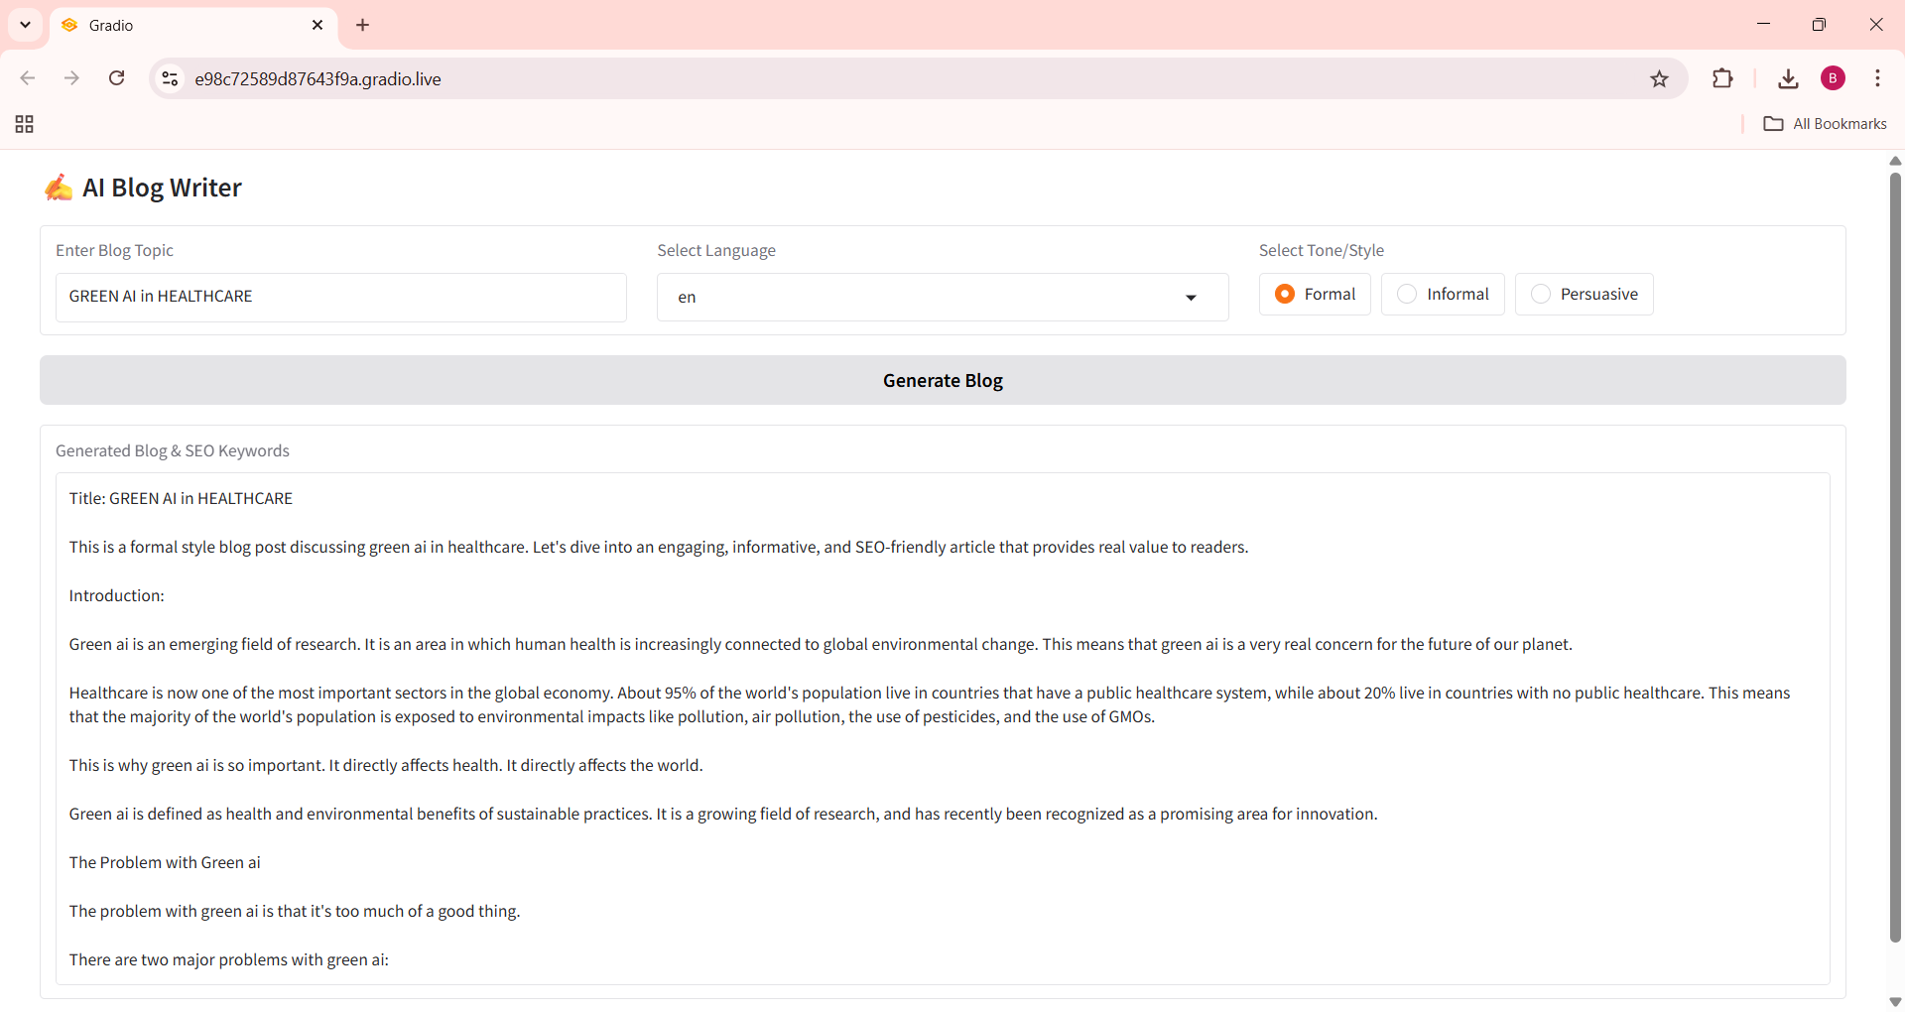
Screenshot of Output:

Slide 8
Conclusion:
This project showcases how NLP and AI can assist in creative writing and content generation.
It enables non-writers, marketers, and bloggers to produce high-quality content effortlessly.
Future improvements can include:
Adding image suggestions using APIs (like Unsplash)
Supporting more tones and SEO optimization levels
Deploying the app on the web via Streamlit or Hugging Face Spaces

